Slide 1
SNR Improvement report of NON-Uniform sampling adc
- Hao Xiang Yang

Slide 2
Plan
What
How
Why

Slide 3
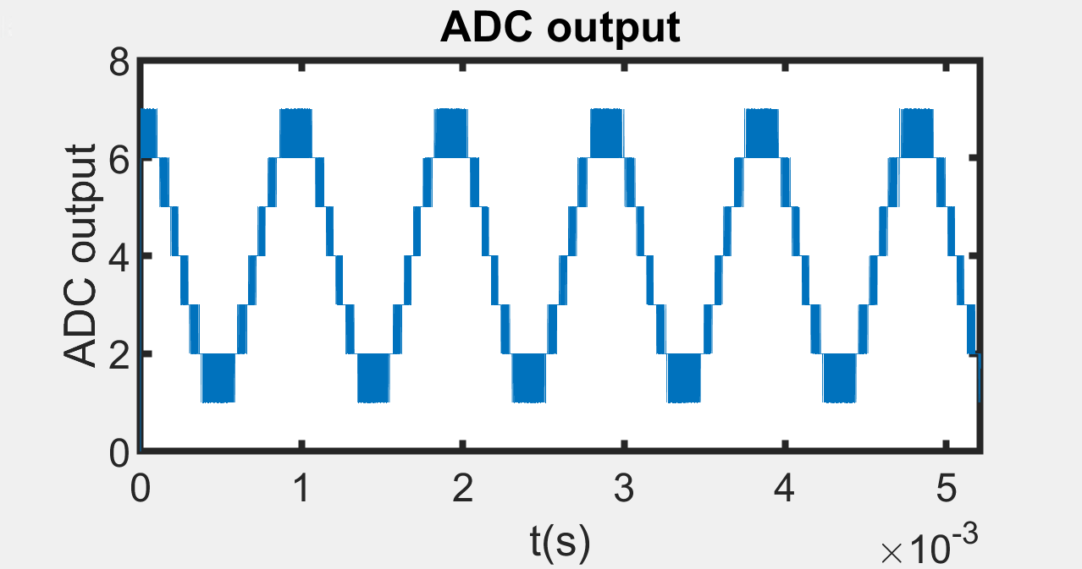
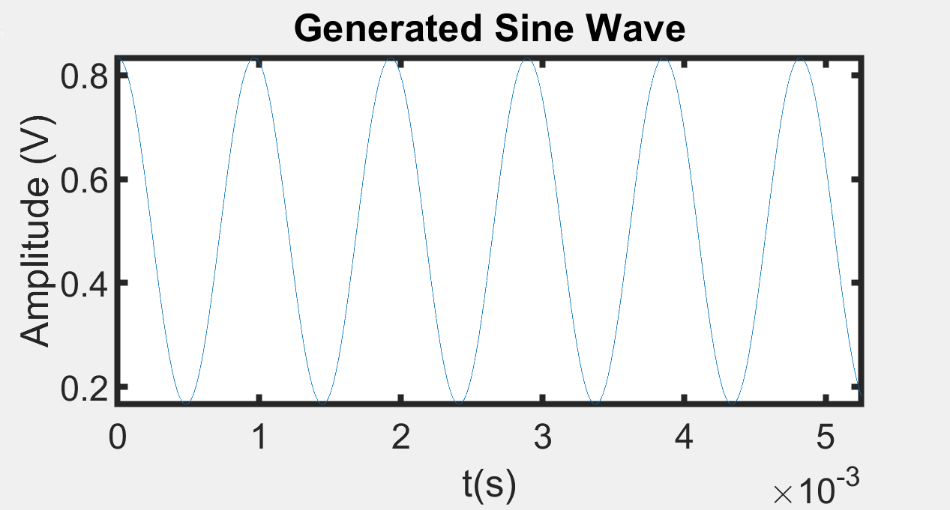
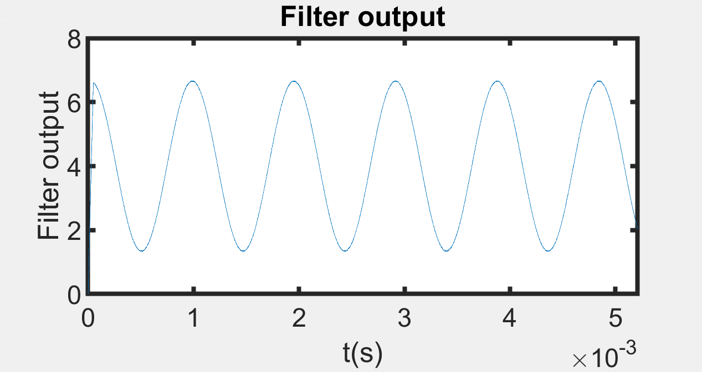
Oversampling adc

Slide 4
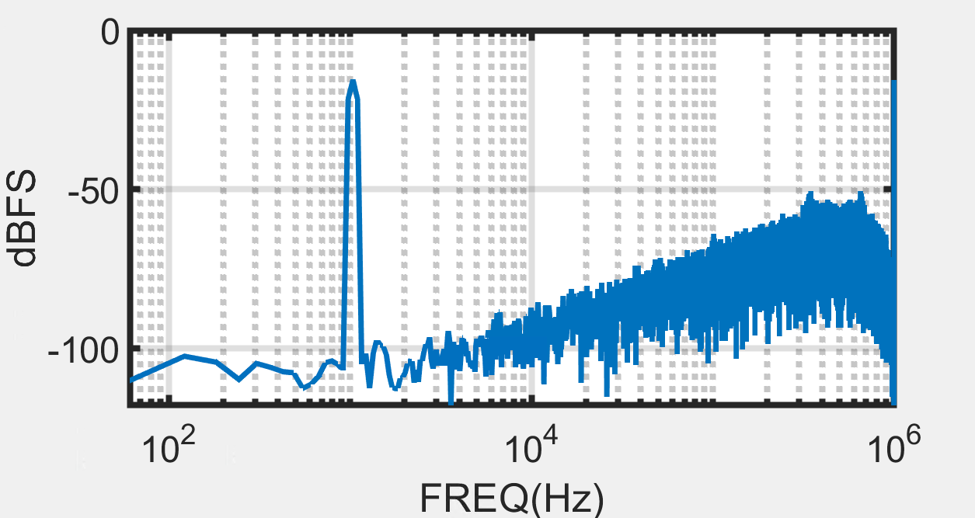
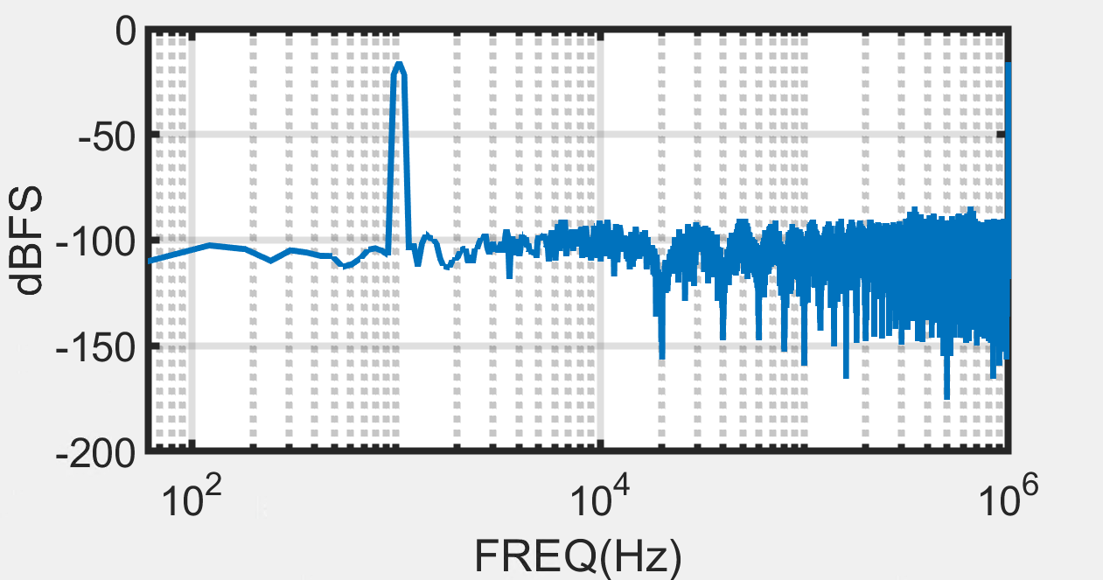
DSM ADC
Fin = 1037.5977 Hz
SNDR = 50.7996 dB
BW = 25.0000 kHz
Fin = 1037.5977 Hz
SNDR = 61.1256 dB
BW = 25.0000 kHz

Slide 5
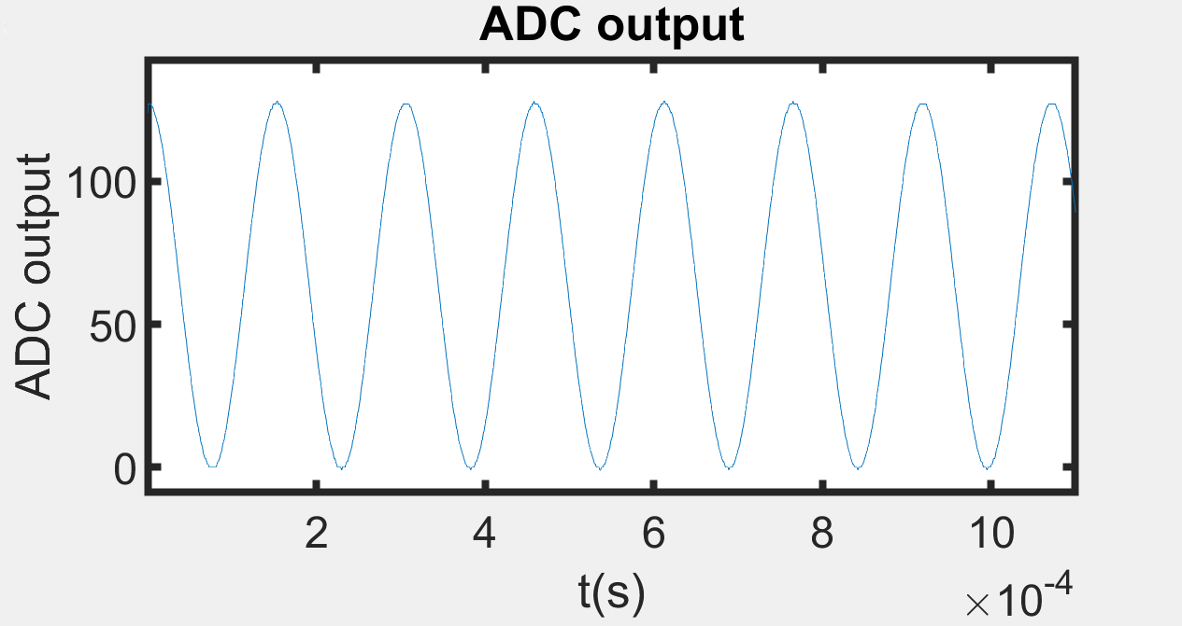
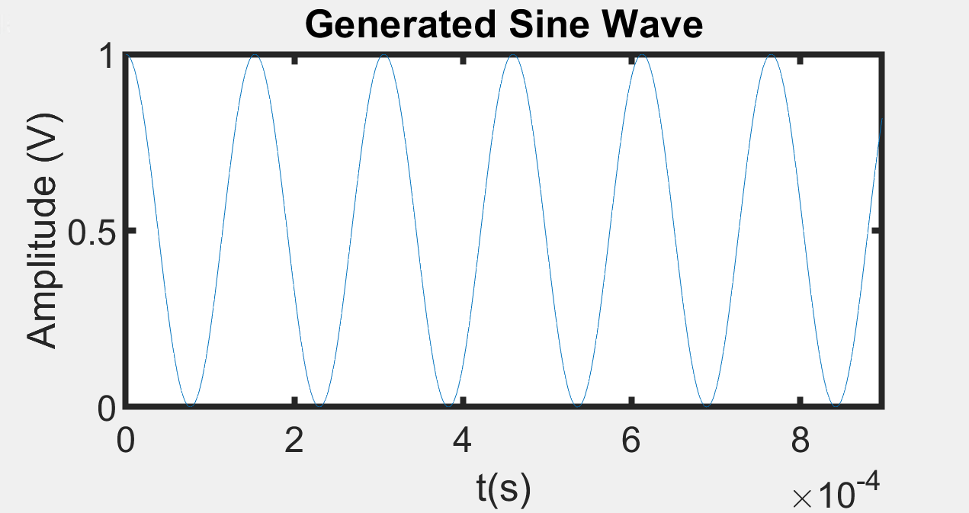
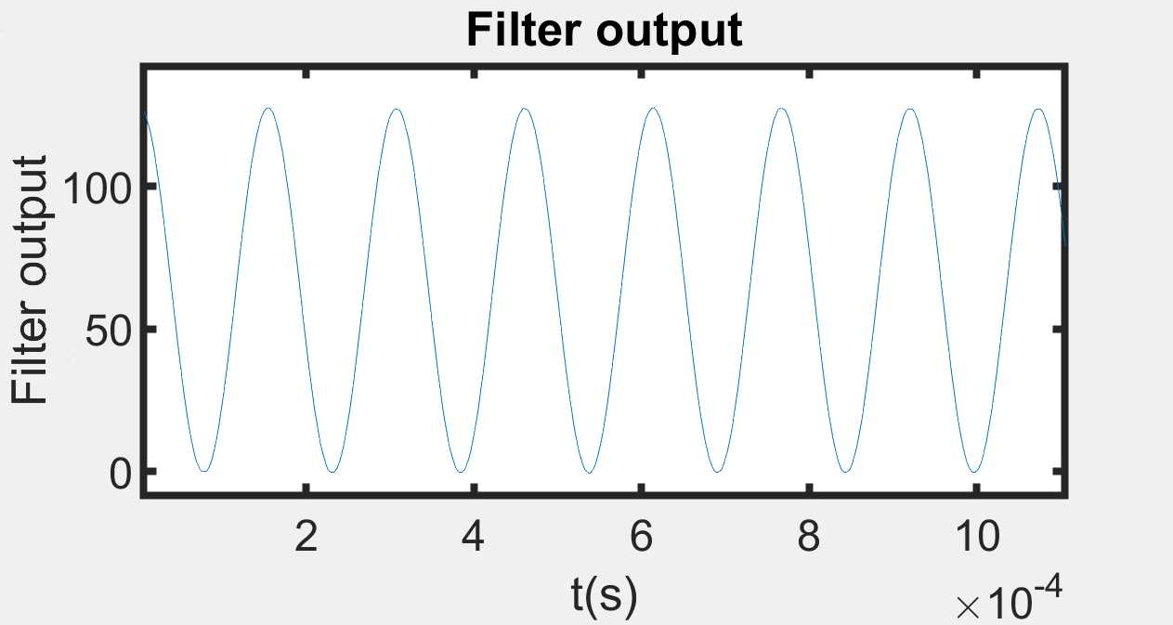
Conventional Adc

Slide 6
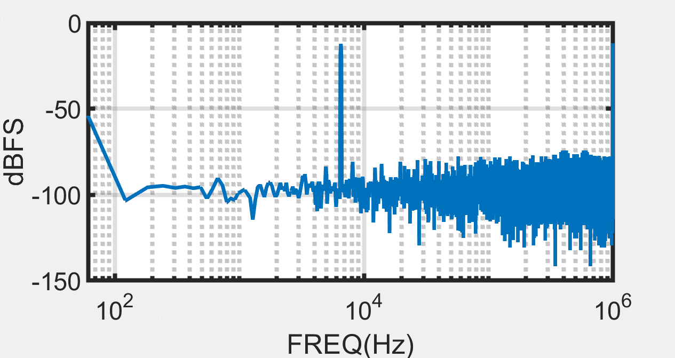
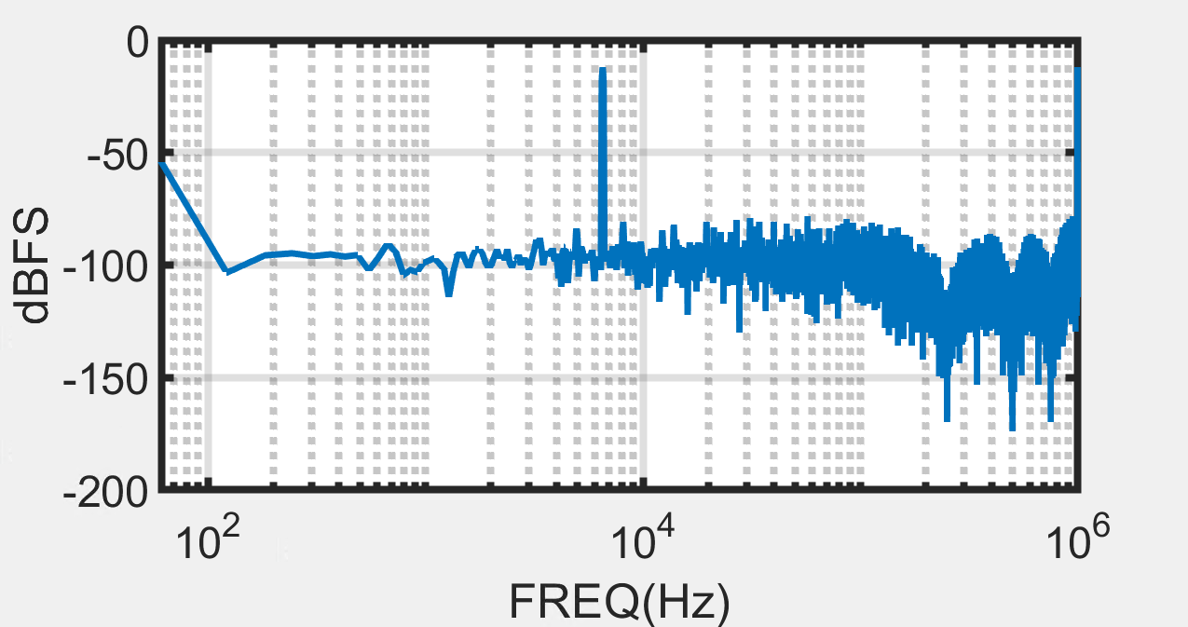
FLASH ADC
Without filter
Fin = 6530.7617 Hz
SNDR = 49.8729 dB
BW = 125.0000 kHz
With filter
Fin = 6530.7617 Hz
SNDR = 50.9925 dB
BW = 125.0000 kHz

Slide 7
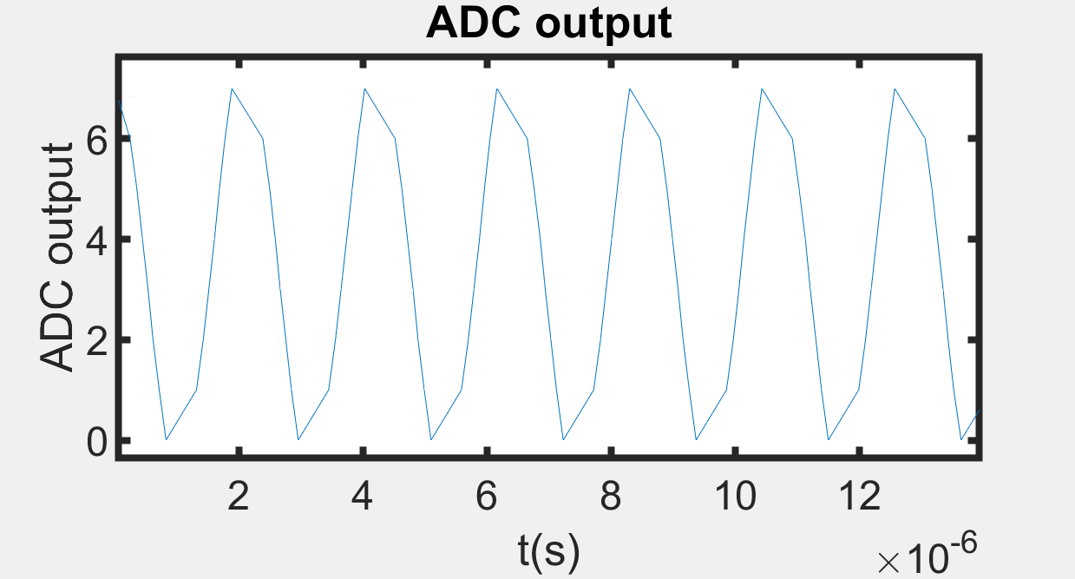
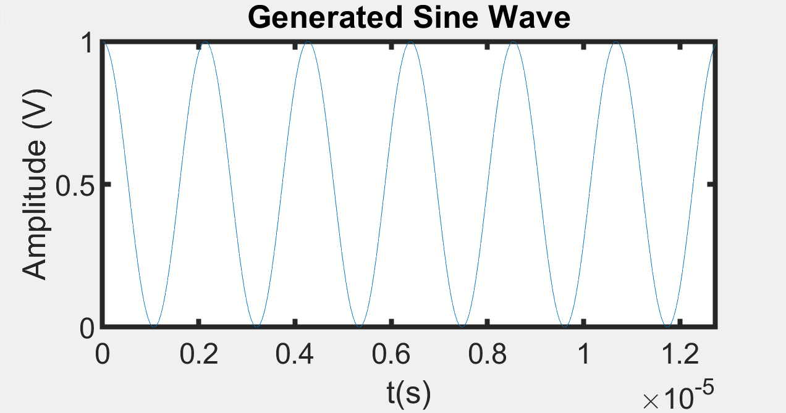
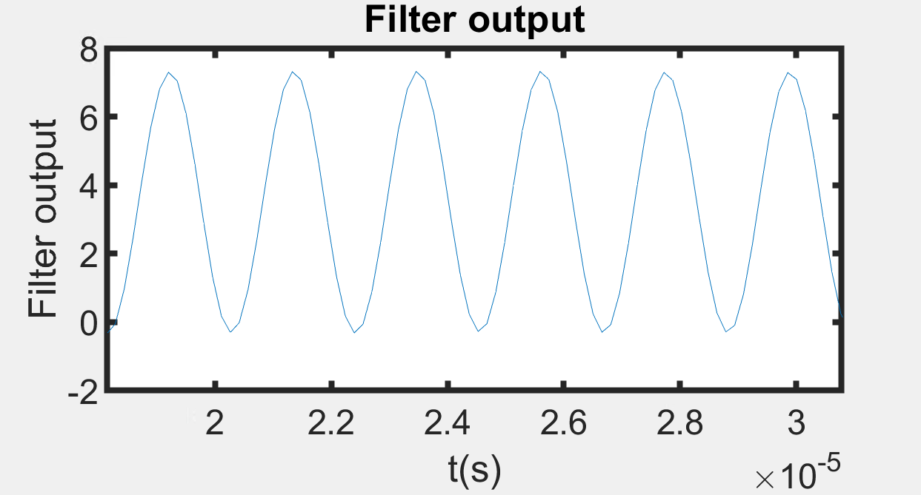
NON-uniform sampling adc

Slide 8
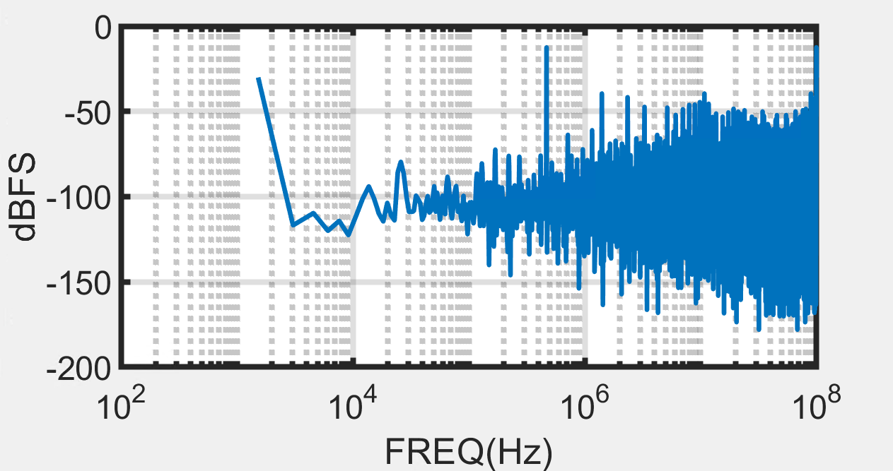
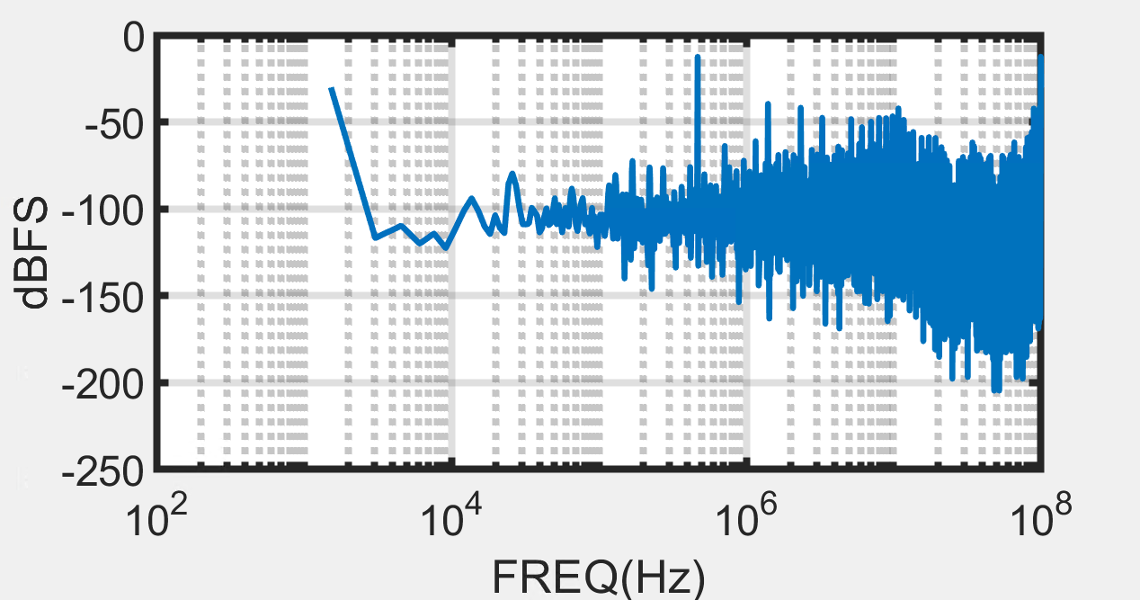
Fin = 468444.8242 Hz
SNDR = 65.2642 dB
BW = 125.0000 kHz
Fin = 468444.8242 Hz
SNDR = 65.2595 dB
BW = 125.0000 kHz

